Slide 1
Medical Health Record Series
Project Contributors: Sabur Oladipupo BELLO

Slide 2
Rationale Statement
This project seeks to develop supervised Decision Tree and Random Forest classification models for Mr. John Hughes. The dataset contains MHR (Medical Health Records)
The dataset consists of 1014 observations and 7 variables that contain information about:
Independent Variables:
Age: : Any ages in years when a women during pregnant
Systolic BP: Upper value of Blood Pressure in mmHg, another significant attribute during pregnancy
Diastolic BP: Lower value of Blood Pressure in mmHg, another significant attribute during pregnancy g
BS: Blood glucose levels is in terms of a molar concentration, mmol/L
BodyTemp: Body Temperature in Fahrenheit
HeartRate: A normal resting heart rate in beats per minute
Dependent Variable:
Risk Level: Predicted Risk Intensity Level (High Level, Mid Level, Low Level)
The goal is to forecast risk level for MHR dataset, by predicting each observation belongs to the most commonly occurring class of training observations in the region to which it belongs.
By leveraging Decision Tree, Random Forest models, and Associated Model Analysis, this supervised learning algorithms will be created to predict the Risk Intensity Level given the features of the dataset.

Slide 3
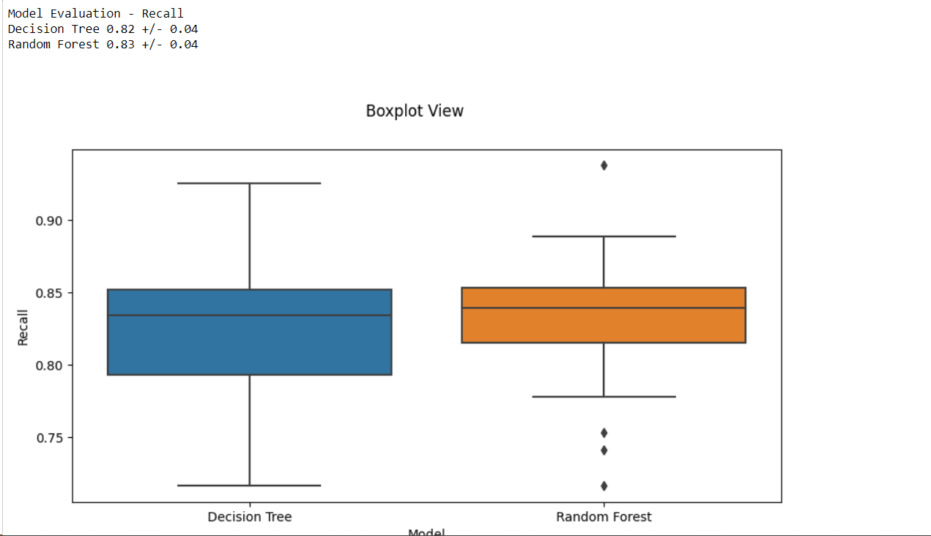
Key Insights from the Output metrics and Box Plots
Output Metrics:
The Random Forest model has a higher Recall value (0.83) compared to the Decision Tree model (0.82). Recall measures the percentage of correctly predicted positive instances out of all the actual positive instances.
Boxplot Visualization of the Recall Value of the Decision Tree and Random Forest Classifiers
Boxplot provides a visual summary of the performance of the two models, allowing us to compare the Recall values of our models.
The Decision Tree classifier has longer tails and more largely distributed. Although, the Random Forest Classifier has outliers that require further investigation, the Random Forest classifier has a narrower range of the Recall data points around the median.

Slide 4
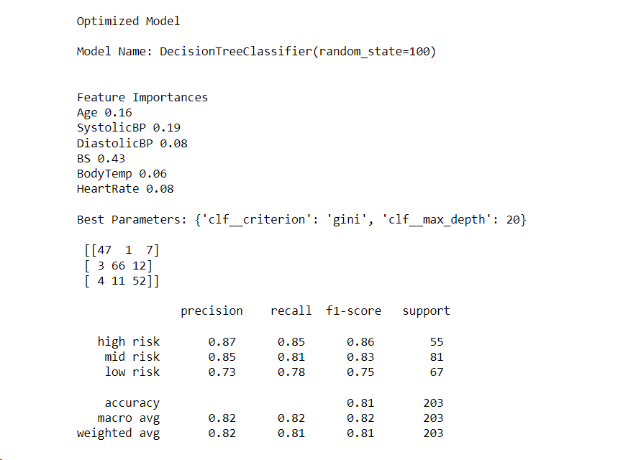
Confusion Matrix/Classification Report – Optimized Decision Tree Model
Precision: The precision (performance metric) of the optimized model for the “low risk" level is 0.73, on the “mid risk” level it is 0.85 while for the “high risk" class, it is 0.87
This indicates that the model has a high ability to correctly identify high risk and mid risk, while it performed moderately high identifying for low risk level.
‘Low risk’ predictions still produces a slightly considerable amount of false positive
Recall: The ‘high risk’ level (0.85) has the highest proportion of actual positives which were correctly classified. The proportion of the models which produced false negatives for ‘high risk” is closely followed by ‘mid risk’ level (0.81), and ‘low risk’ identification (0.78, i.e. 78% recall rate)
F1-Score: With very similar values, the high risk and mid risk predictions show a fairer glean to a perfect model than the combination of precision and recall – F1 score of the low risk at 0.75
Accuracy: The optimized Decision Tree model is only making predictions right 81% of the time
Support: The number of metrics are quite closely split (27% - 40% - 33%; 100% = 203)
Because our classes are relatively balanced that’s why our Macro Avg and Weighted avg are quite similar.
Macro Avg and weighted Avg are the average precision and weighted average precision of precision, recall and F1 score. Weighted average favors the majority class.

Slide 5
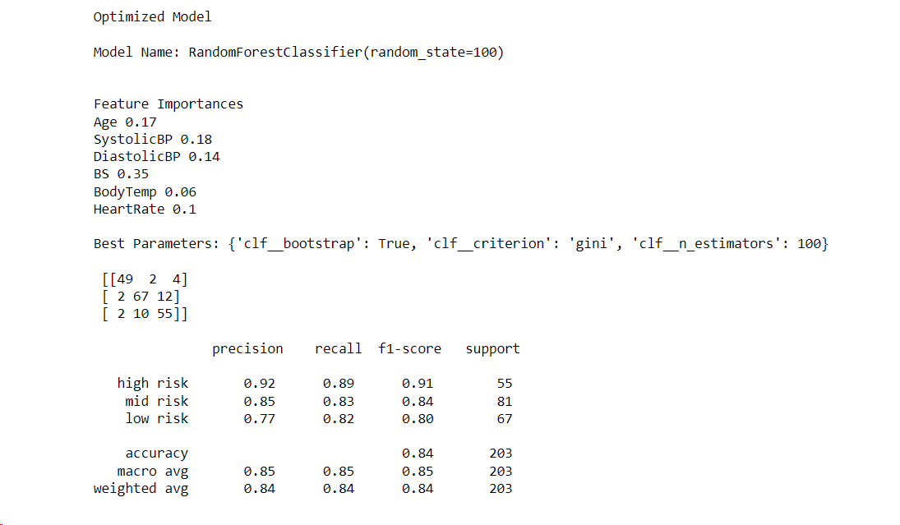
Confusion Matrix/Classification Report – Optimized Random Forest Model
Precision: The precision (performance metric) of the optimized model for the “low risk" level is 0.77, on the “mid risk” level it is 0.85 while for the “high risk" class, it is 0.92
This indicates that the model has a high ability to correctly identify high risk and mid risk, while having a moderately high ability to identify ‘low risk’ events.
Although only slightly, low risk predictions still produces a considerable amount of false positives
Recall: The ‘high risk’ level (0.89) has the highest proportion of actual positives which were correctly classified. The proportion of the models which produced false negatives for ‘high risk” is closely followed by ‘mid risk’ level (0.83), and ‘low risk’ identification (0.82, i.e. 82% recall rate)
F1-Score: With very similar values, the high risk and mid risk predictions show a fairer glean to a perfect model than the combination of precision and recall – F1 score of the low risk at 0.80
Accuracy: The optimized Random Forest model is making predictions right 84% of the time
Support: The number of metrics are quite closely split (27% - 40% - 33%; 100% = 203)
Because our classes are relatively balanced that’s why our Macro Avg and Weighted avg are quite similar.
Macro Avg and Weighted Avg are the average precision and weighted average precision of precision, recall and F1 score. Weighted average favors the majority class.

Slide 6
Confusion Matrix/Classification Report (cont.)
Decision Tree
Decision Tree Classifier
High Risk: 47 instances while classified correctly (TP), while classifying 1 and 7 instances of mid risk and low risk (FP).
Mid Risk: 66 instances of Mid risk were classified correctly (True Positive), when 3 high risk and 12 high risk predictions respectively (FP).
Low risk: 52 instances of Low risk were classified correctly (True Positive), when 4 high risk and 11 mid risk predictions respectively. (FP).
Random Forest Classifier
High Risk: 49 instances while classified correctly (TP), while classifying 2 and 4 instances of mid risk and low risk (FP).
Mid Risk: 67 instances of Mid risk were classified correctly (True Positive), when 2 high risk and 12 high risk predictions respectively (FP).
Low risk: 55 instances of Low risk were classified correctly (True Positive), when 2 high risk and 10 mid risk predictions respectively. (FP).
Random Forest Classifier

Slide 7
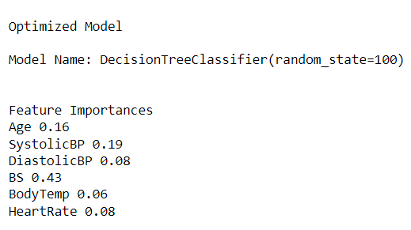
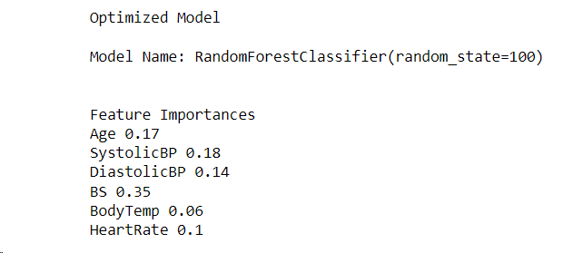
Insights from Feature Importance
Feature importance refers to techniques that assign a score to input features based on how useful they are at predicting a target variable.
The scores are useful and can be used in a range of situations in a predictive modeling problem, such as:
• Better understanding the data.
• Better understanding a model.
• Reducing the number of input features.
Decision Tree Classifier:
The results suggest perhaps three of the 10 features (Age, SystolicBP, and DiastolicBP) as being important to prediction. Bodytemp is the least important feature.
Random Forest Classifier:
The more important features here are BS, SystolicBP, Age, and DiastolicBP. BodyTemp is the least important feature.

Slide 8
Recommendations
Precision and Recall are valuable – considering the MHR (Medical Health record), the model is very critical we want higher True Positive Rate, and low False Positive rate. Although both algorithms have similar results, the Random Forest algorithm classifies ‘low risk’, ‘mid risk’, and ‘high risk’ instances slightly better than the Decision Tree model.
The MHR dataset doesn’t have a large class imbalance; the 84% Accuracy of the Random Forest model is an indicator metric slightly greater than 81% Accuracy of Decision Tree algorithm.
The Decision Tree and Random Forest models classification and performance metrics are very similar. However, considering the interpretability of the models, Random Forests are often considered as "black-box" models, while Decision Trees are more interpretable.

